Slide 1
R Clinic
Writing a function

Slide 2
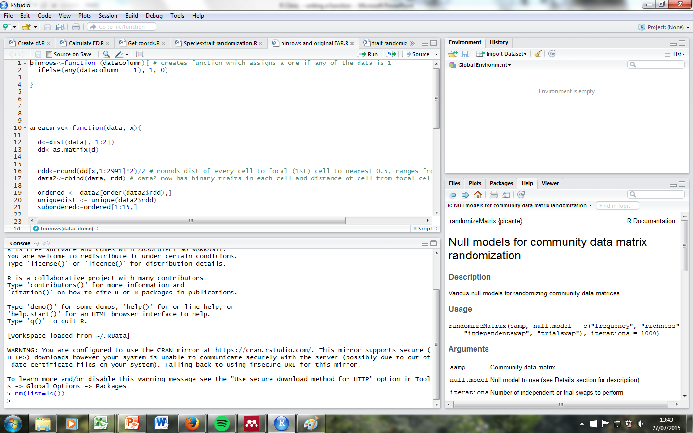
Follow along
More of an interactive session

Slide 3
Why write your own function?
Cleaner code – shorter and more readable
Less repetitive
Don’t try to do too much in one function
‘Nice’ code
Use them in apply functions e.g. tapply (we’ll learn about these next time)

Slide 4
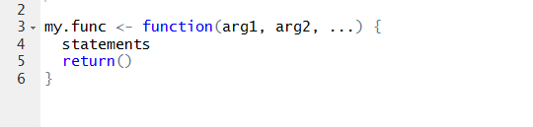
Structure

Slide 5
Hints and tips
return () exits function but not always necessary
print() is also a useful sanity check
Use stop() to add your own error message
Specify argument defaults
Make sure you’re not masking another function

Slide 6
Good practice
Keep them short!!
#######################################
###Comment, comment, comment, comment###
#######################################
Check for errors along the way
Name it something sensible

Slide 7
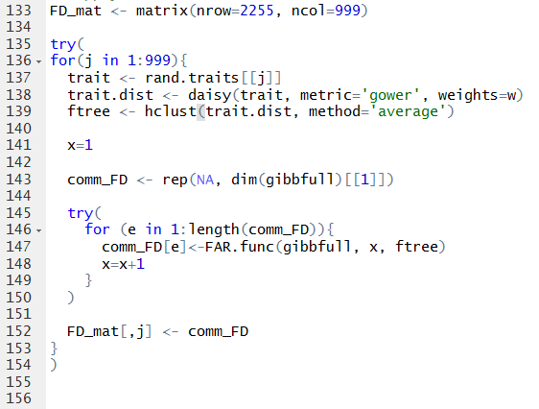
Next week
Loops
Apply family
aggregate()

